Slide 1
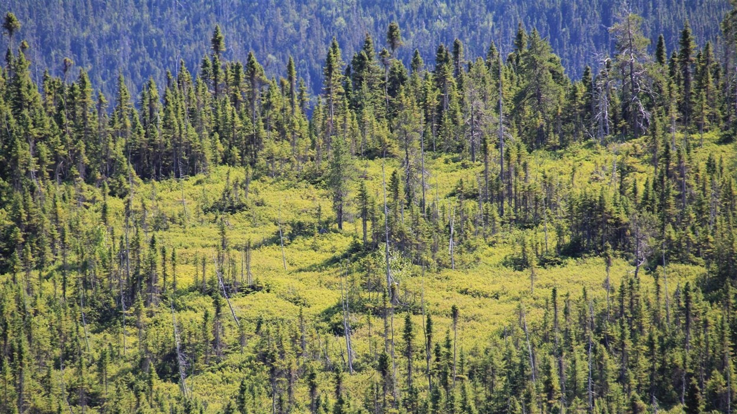




Régénération de l'épinette noire pendant 18 ans après des traitements sylvicoles expérimentaux dans la forêt boréale de l'est du Canada
+
+
Sanghyun Kim
-
-
Superviseurs
Miguel Montoro Girona (UQAT-SLU)
Yves Bergeron (UQAT-UQAM)
Patricia Raymond (MFFP)
Notes:
Salut

Slide 2
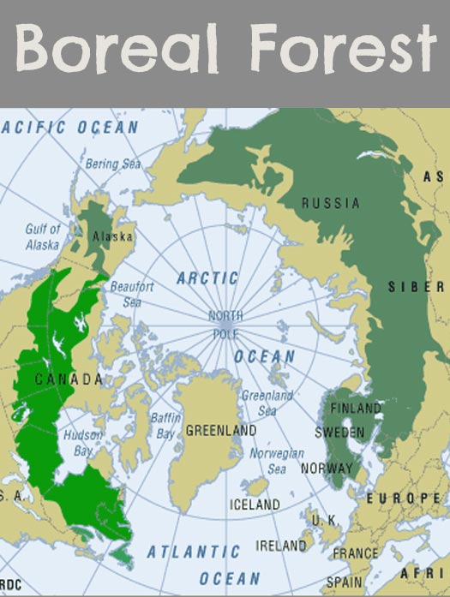




Introduction X
L'importance de la forêt boréale
11.5% of total land area.
1/3 forest area, C stock, timber
The most freshwater
The largest intact forest
Source: thewildclassroom

Slide 3
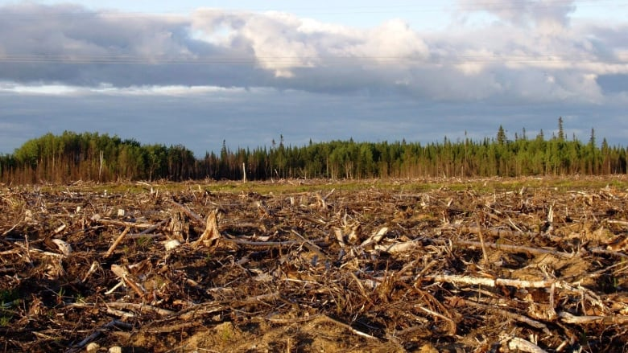
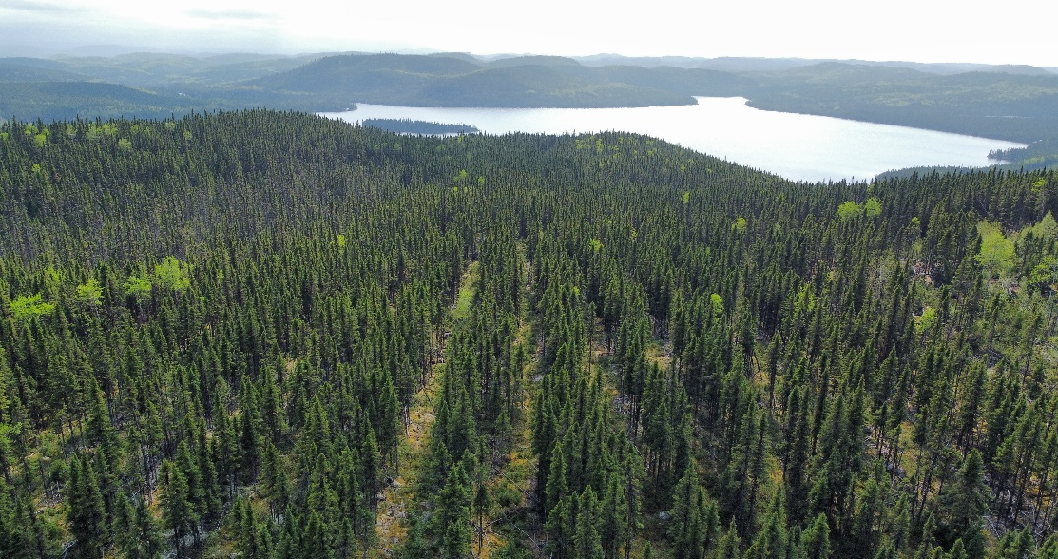
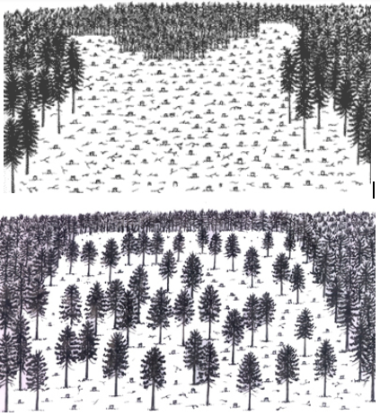



Introduction X
Adoption d'alternatives sylvicoles en forêt boréale
Clearcutting:
All the trees within a designated area are cut down
To maximize harvesting efficiency
Establishment of a single species or even-aged stands
Partial cutting:
Carefully selecting & removing specific trees
To narrow gaps between natural & managed forest
A more diverse forest structure
30%
44%
80%
Source: CBC, Ruben Leroy

Slide 4
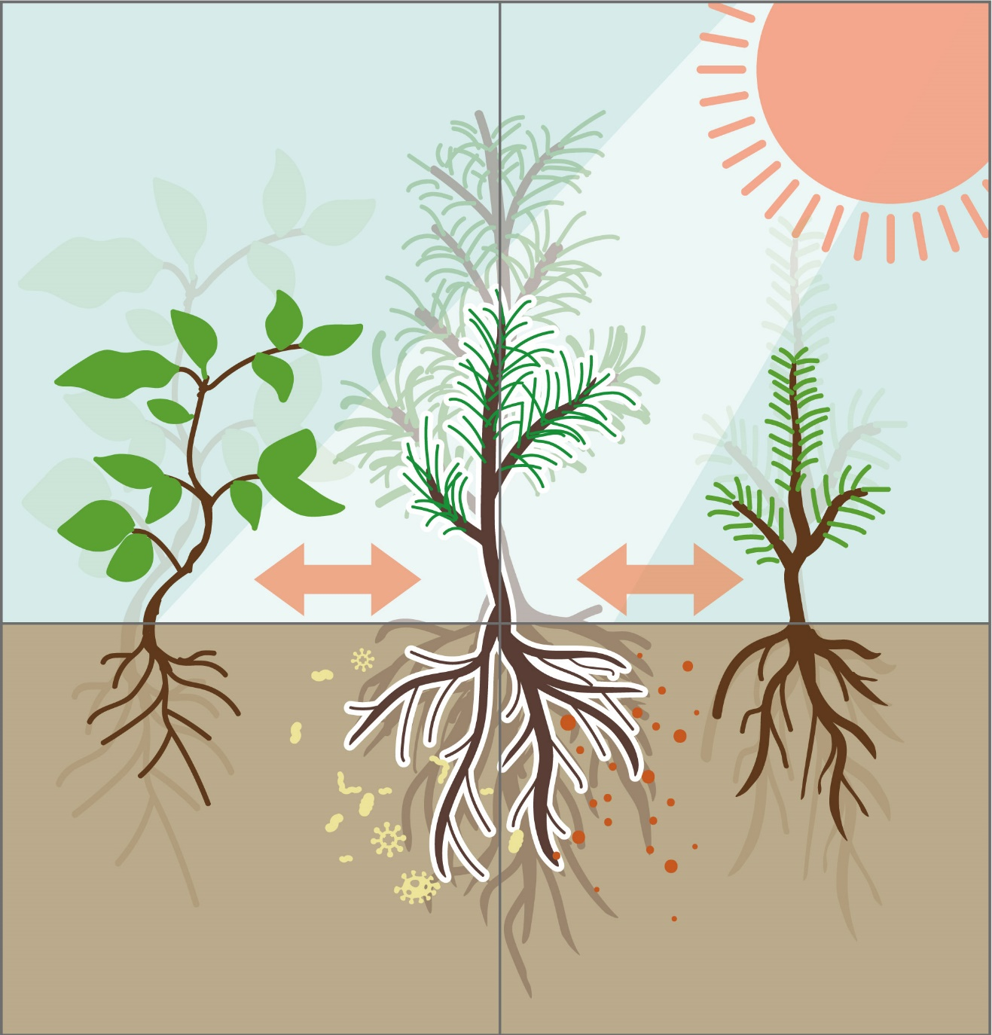
Introduction X
Facteurs déterminants de la régénération naturelle dans la forêt boréale
Climate
Driven by combination of environmental factors and intricate ecological relationships
Seed availability: dispersal & abundance
Climate: temperature, precipitation
Microsite condition: light, disturbances
Competition: allelopathic chemicals, resources
Soil condition: soil nutrients, soil microorganisms
Process by which forests replenish themselves through the establishment and growth of new trees without any human intervention.
Microsite
Competition
Seed availability
Soil condition
Source: Sanghyun Kim

Slide 5
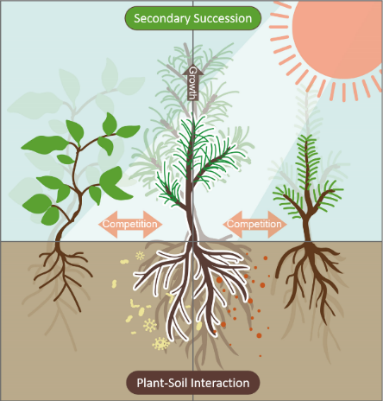
Introduction X
Régénération des conifères après une coupe partielle dans les pessières noires
Objectives:
Evaluate the long-term impacts of experimental silvicultural treatments & stand types on seedling growth, density & regeneration driving factors in black spruce boreal forests.
1. Regeneration Dynamics
Hypothesis:
Uniform Shelterwood System with spot scarification will favor the establishment of black spruce seedlings than shade-intolerant deciduous plants.

Slide 6
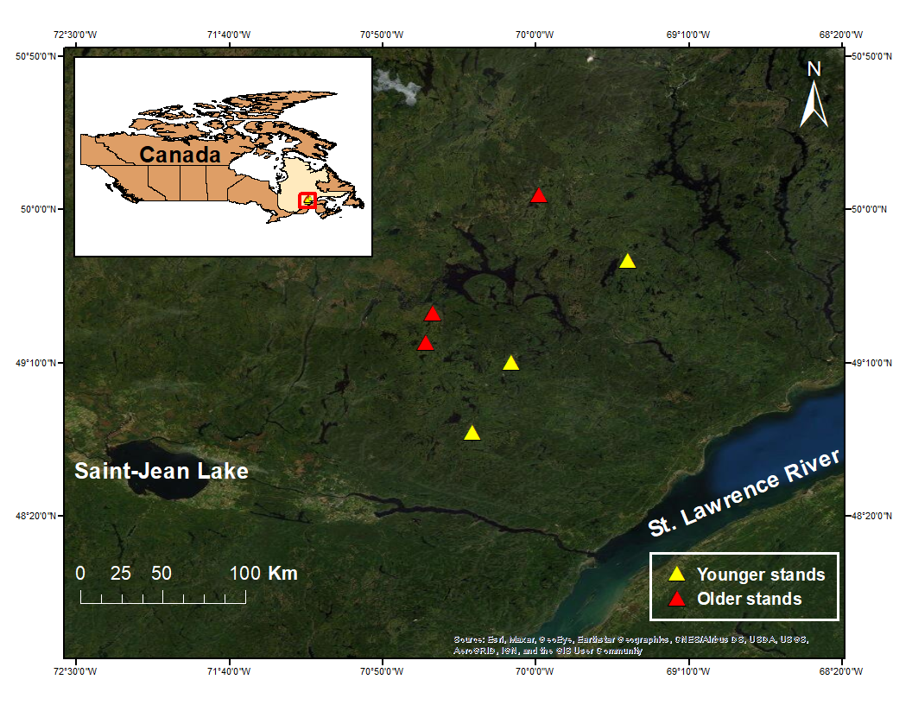
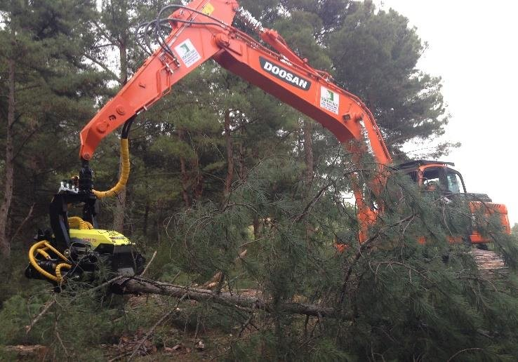
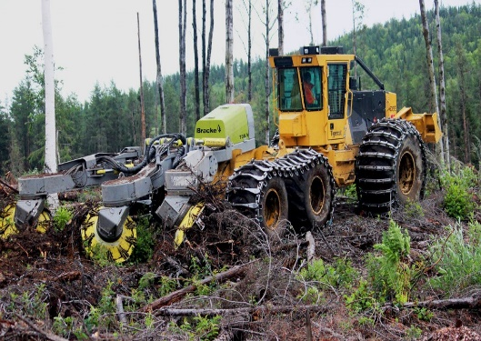
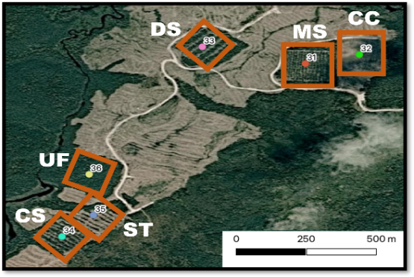
Methods
Zone d'étude
6
Harvesting (2003)
Spot scarification (2004)
3
Natural even-aged black spruce stands
Northern Saguenay & North Shore
Younger (2,316 trees/ha, 79yr) & Older (1,272 trees/ha, 156 yr) stands from fire history
4
5
2
1

Slide 7

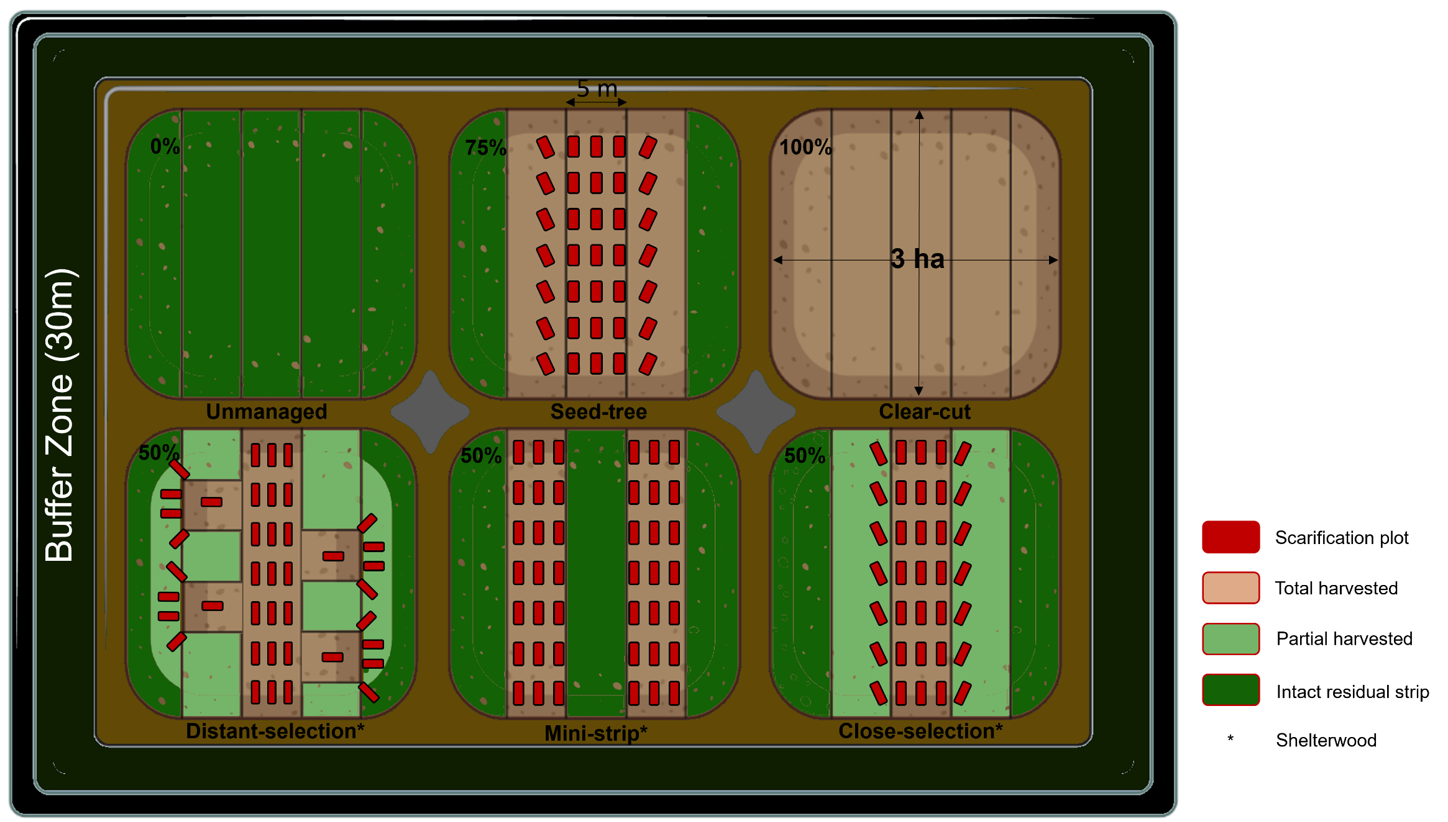
Methods X
Traitements sylvicoles
3 variants of uniform shelterwood system: Close-selection, Distant-selection, Mini-strip
-Harvesting intensity
-Spatial pattern
-Proportion of scarification

Slide 8
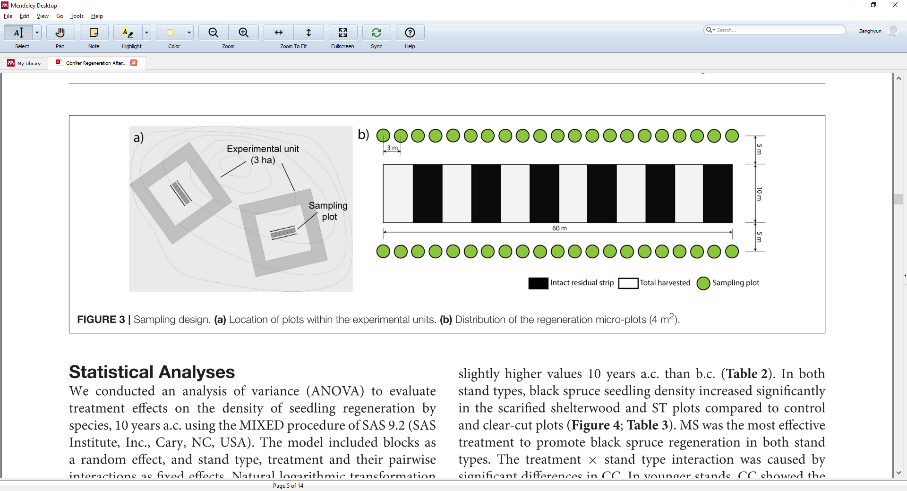
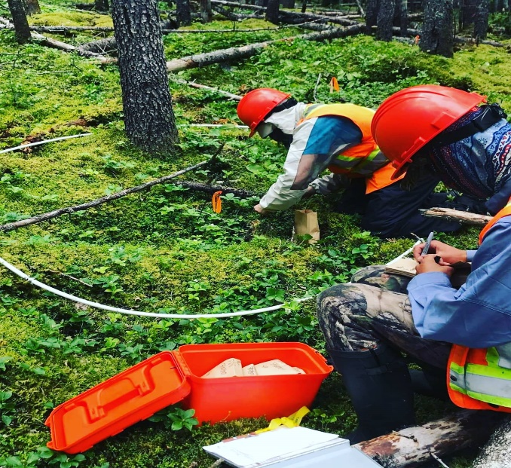
Methods X
Plan d'échantillonnage
Example of Mini-strip (MS) shelterwood harvesting
A factorial in randomized blocks.
3 sites x 2 stand structures x 6 silvicultural treatments = 36 experimental units
x 42 microplots = 1,512 permanent plots
Montoro Girona et al. 2018

Slide 9
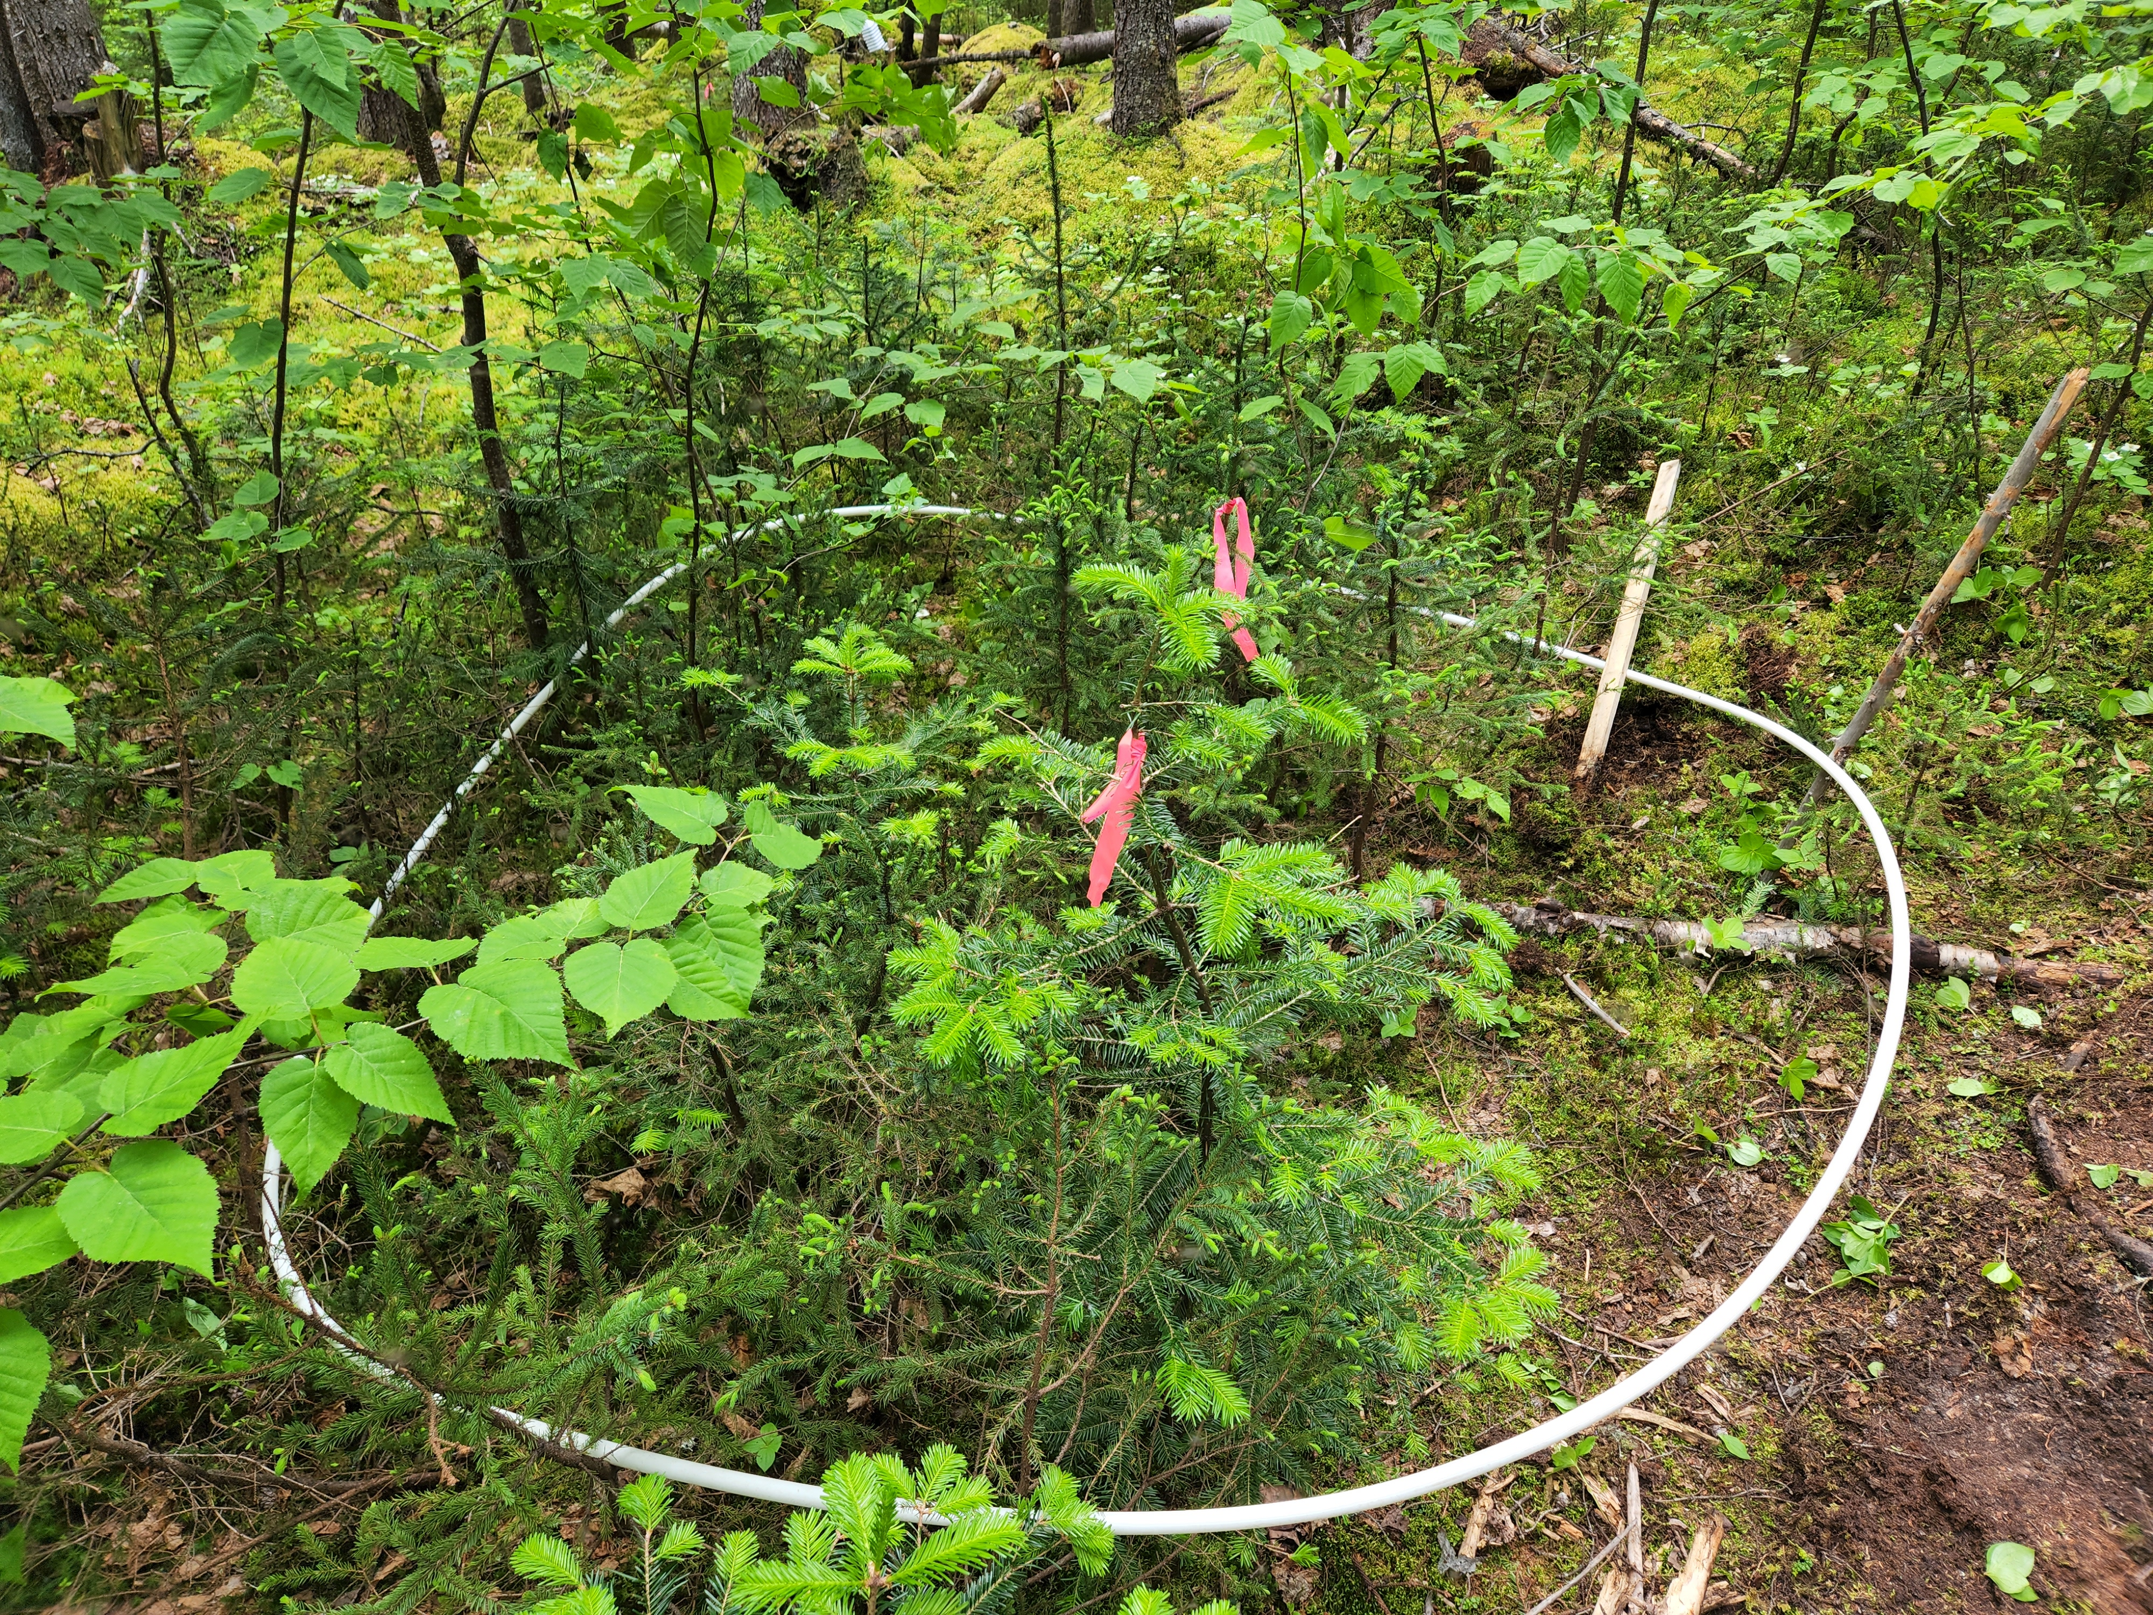
Methods X
X
Évaluations de la régénération
Seedling Density
Count by species & height
Coverage of Kalmia & Ledum
Dominant conifer seedling
Sampling plot
(4m²)
Age
Class
Height
Diameter
Disturbances
Bryophyte cover
Terminal shoot length

Slide 10
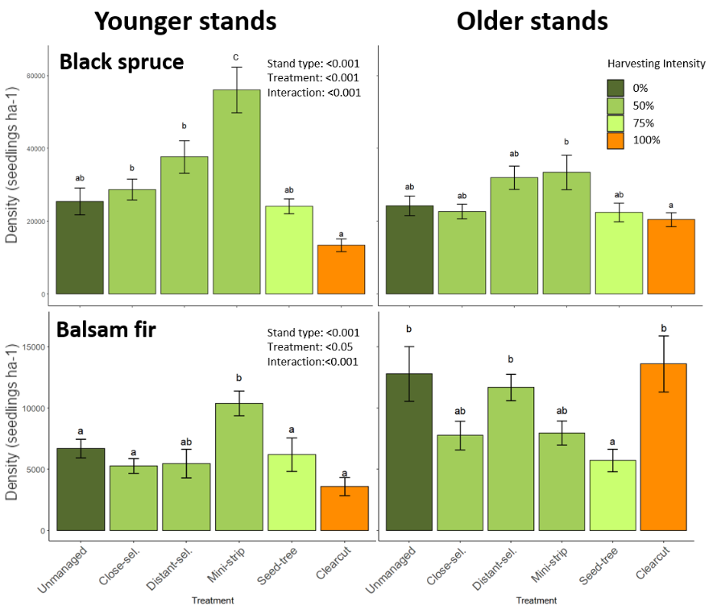
Results X
X
Densité des semis par traitement sylvicole et type de peuplement
Comparing seedling density from each silvicultural treatment in Spruce/Fir & Younger/Older
The most dominant species was black spruce with 311% higher than balsam fir
The most effective to promote Black spruce regeneration – MS in younger: X2 higher, CC: X2 lower. Similar values in older except for MS & CC.
Balsam fir density – X2 higher in Older

Slide 11
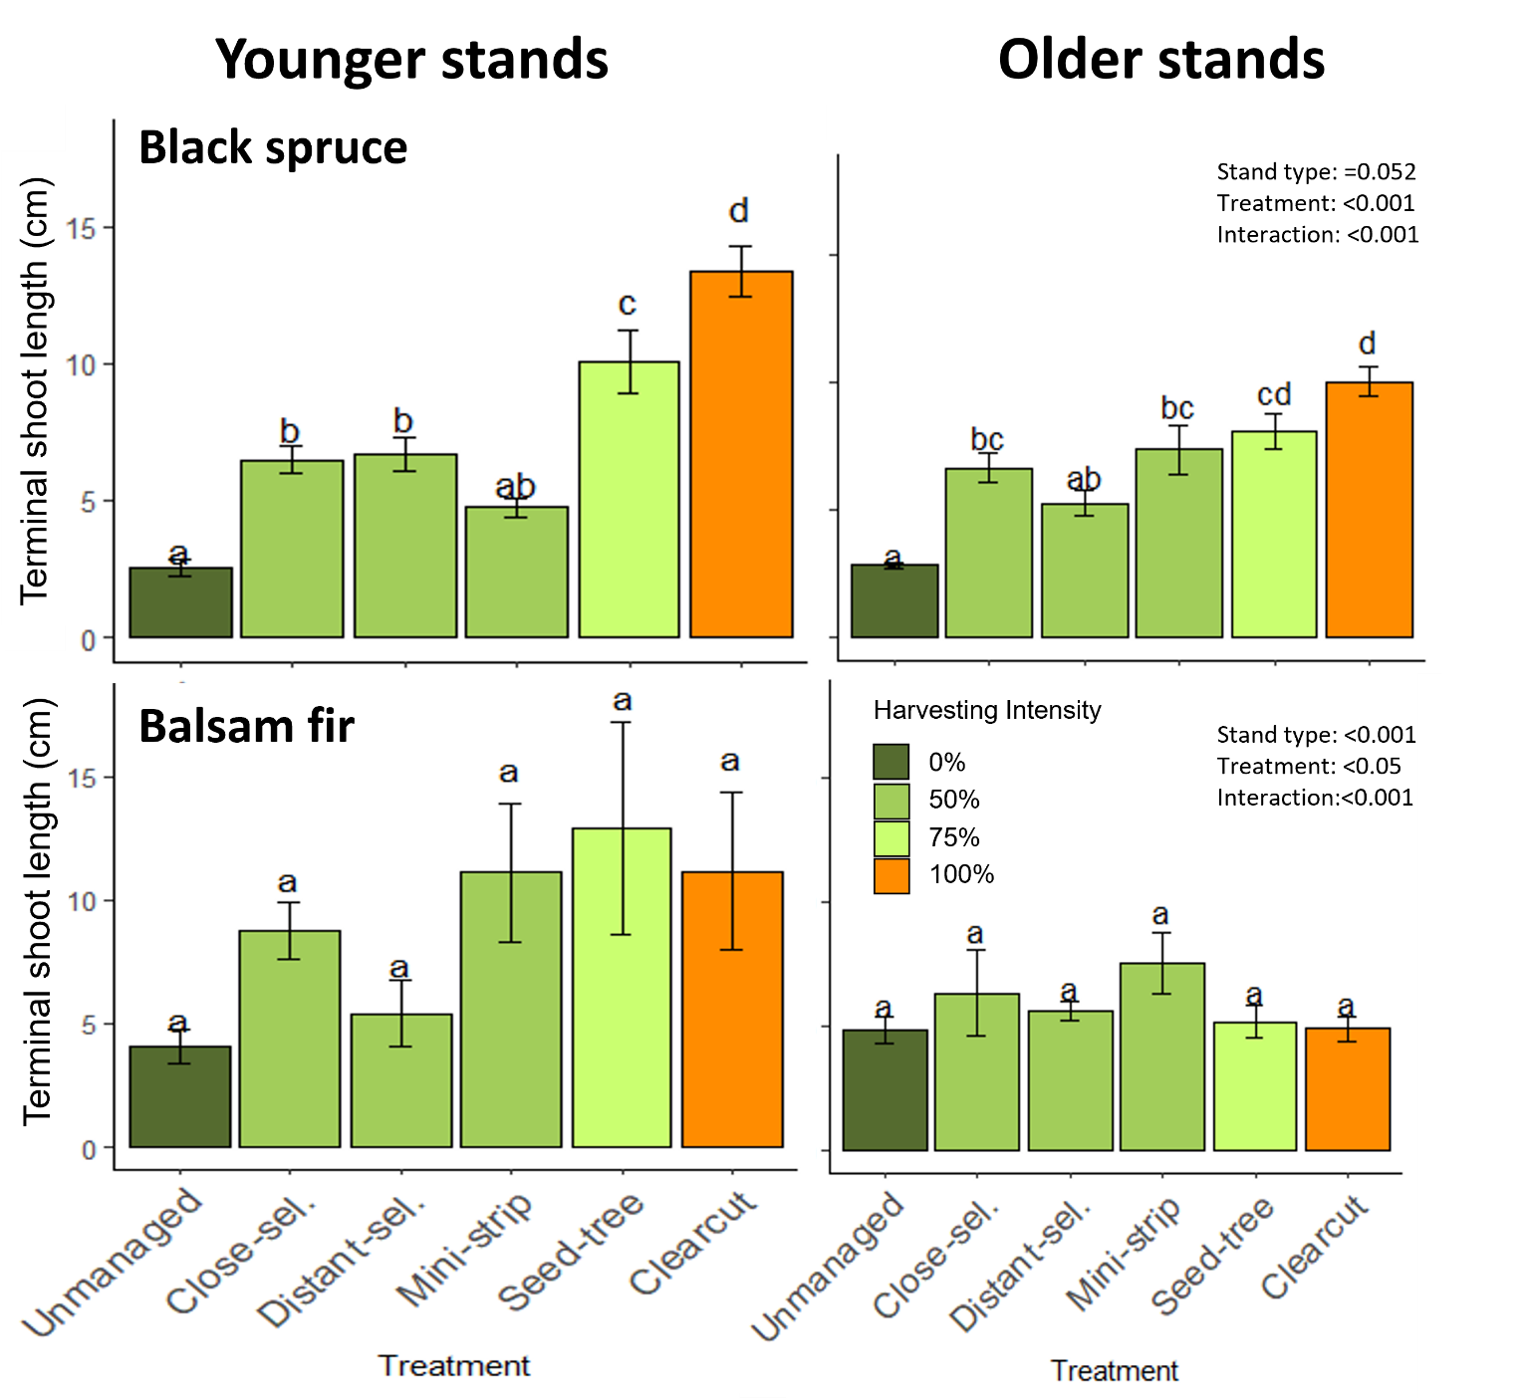
Results X
X
Croissance des semis par traitement sylvicole et type de peuplement
Terminal shoot length was measured as a growth feature in dominant seedlings.
Harvesting promoted seedling growth, and CC was the most effective in black spruce.
Generally, the growth trend was inverse to density -> Intra-specific competition

Slide 12
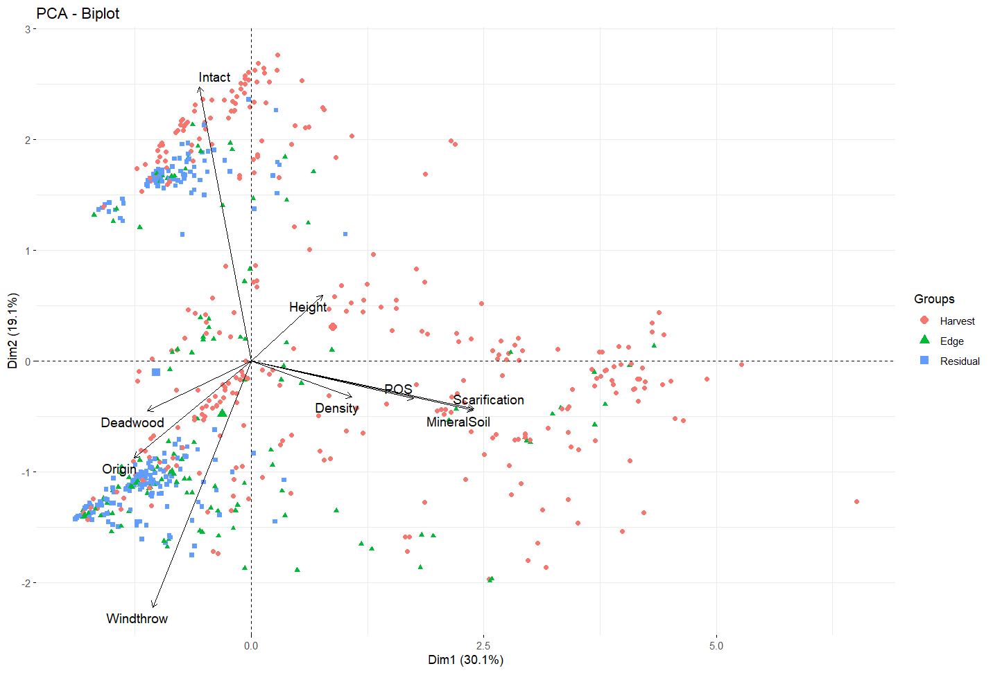
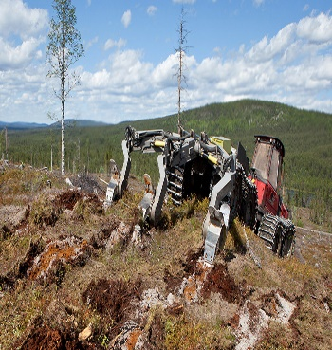
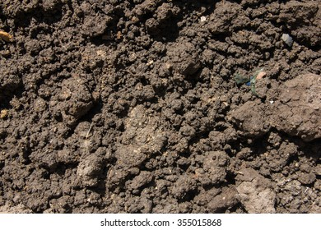
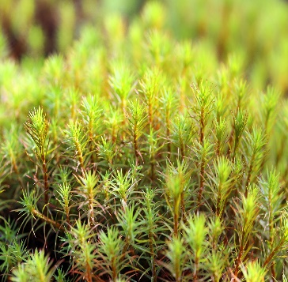
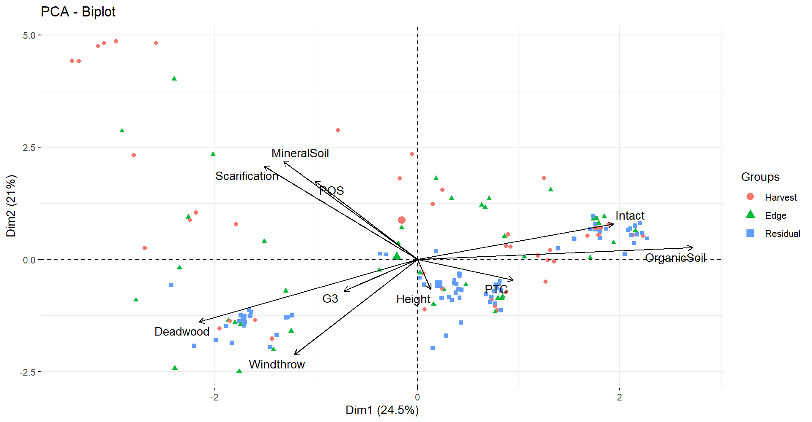
Results X
X
Analyse en composantes principales de la densité des semis d'épicéa noir
PCA, using seedling density and micro-plot characteristics, explained about 49% of the variation for black spruce regeneration
Seedling density was positively correlated with scarification, mineral soil and Polytrichum species
Density
Scarification
Mineral soil
Polytrichum sp.

Slide 13
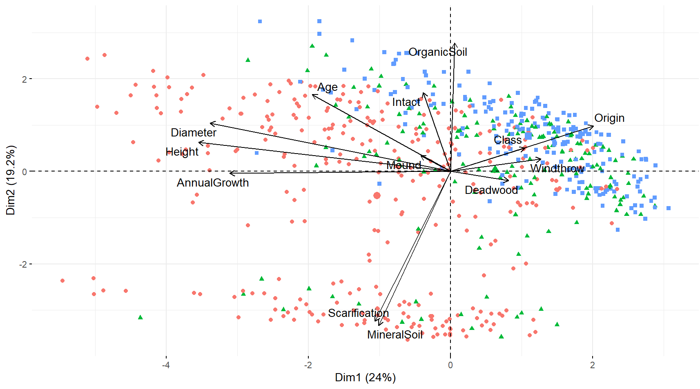
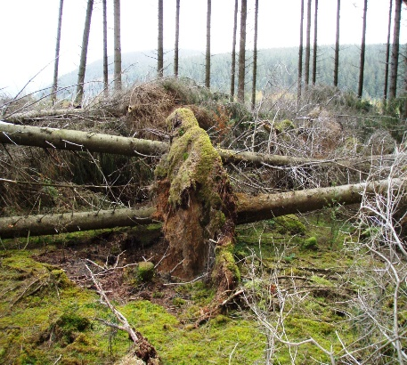
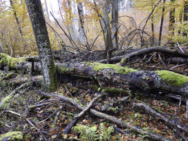
Results X
X
Analyse en composantes principales de la croissance des semis d'épicéa noir
PCA, using seedling growth and micro-plot characteristics, explained about 43% of the variation for black spruce growth
Growth features
Seedling growth was negatively correlated with windthrow and deadwood.
Windthrow
Deadwood

Slide 14
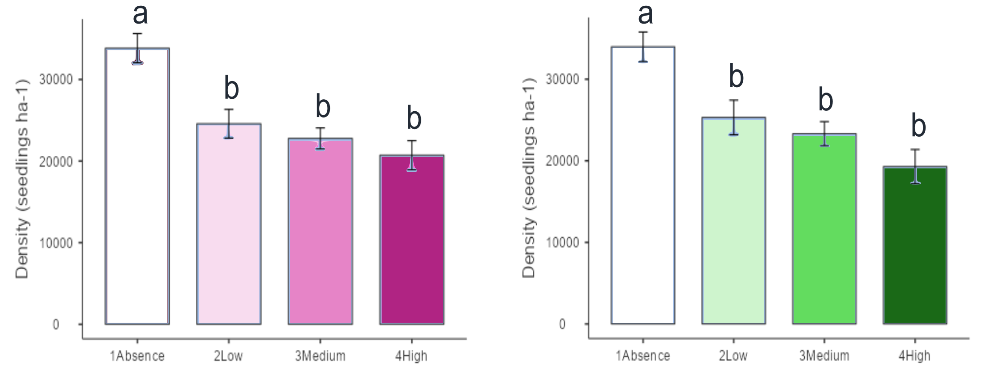


Results X
X
Effets des éricacées sur la densité des semis d'épicéa noir
p < 0.001
p < 0.001
38%
43%
Kalmia angustifolia
Rhododendron groenlandicum
~15%
15-30%
30%~
~15%
15-30%
30%~
  Black spruce seedling density was lower in the presence of Ericaceous shrubs.

Slide 15
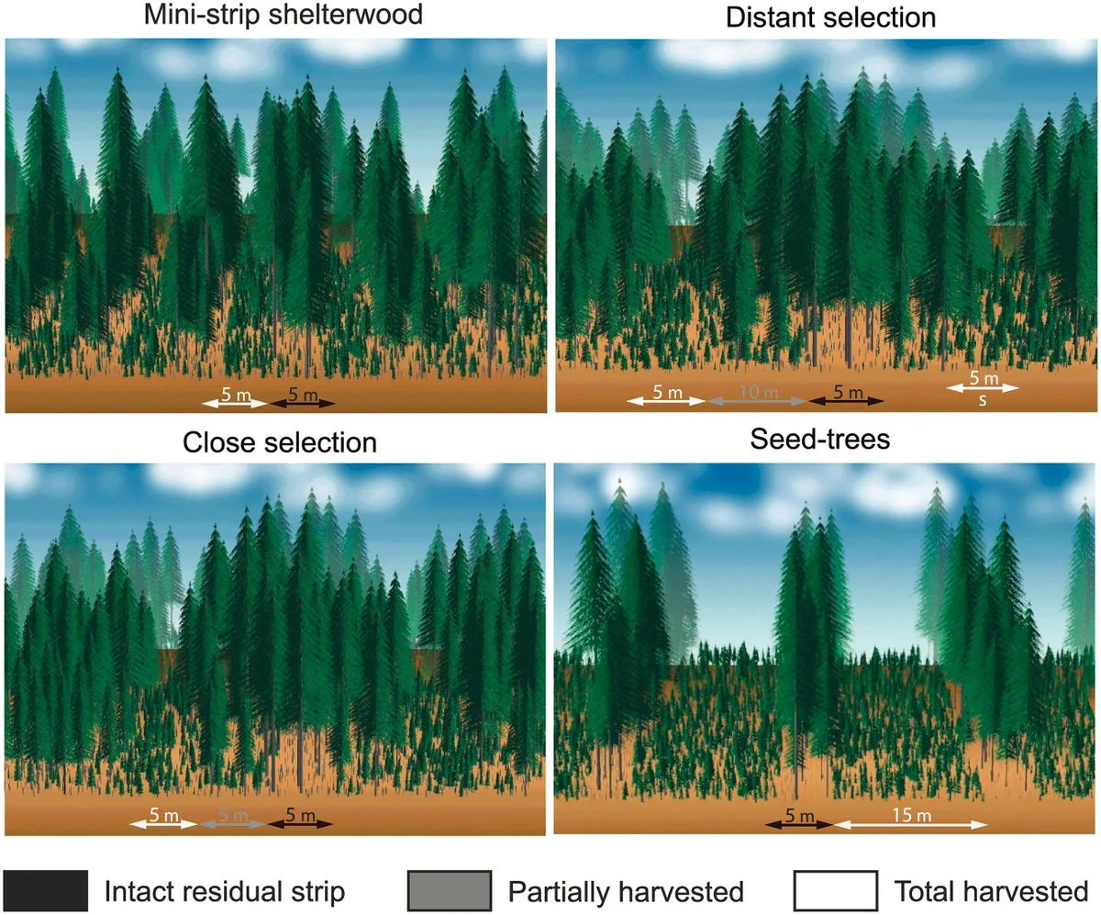
Discussion
X
Vers une gestion durable de la forêt boréale
Partial harvest with scarification promoted the natural regeneration of black spruce in boreal forests (seedling density)
Black spruce regeneration was driven by seedbed conditions, disturbances, and intra- and inter-specific competition
Partial harvest could be modified with additional treatments (tending, micro-site mulching) to improve forest productivity.
Understanding driving factors from belowground ecosystem is needed to explain the effects of micro-plot characteristics on black spruce regeneration.
Montoro Girona et al. 2018

Slide 16
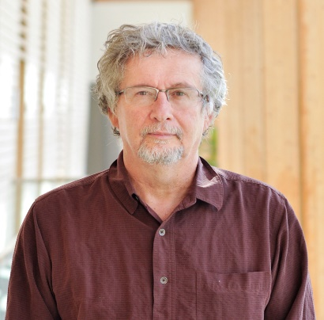















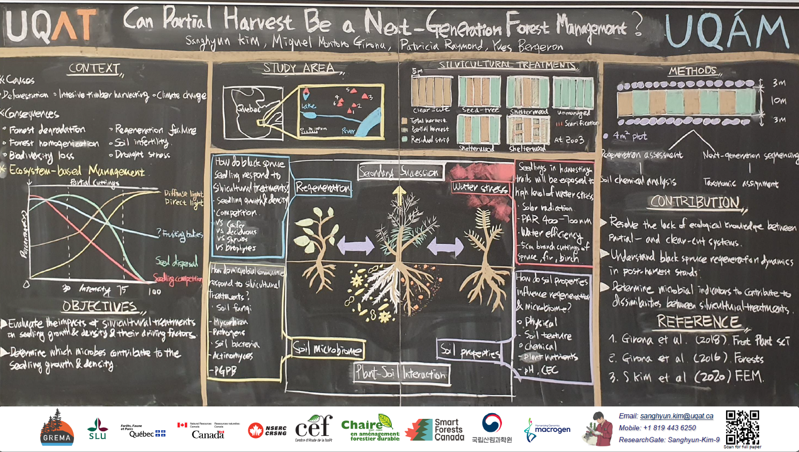
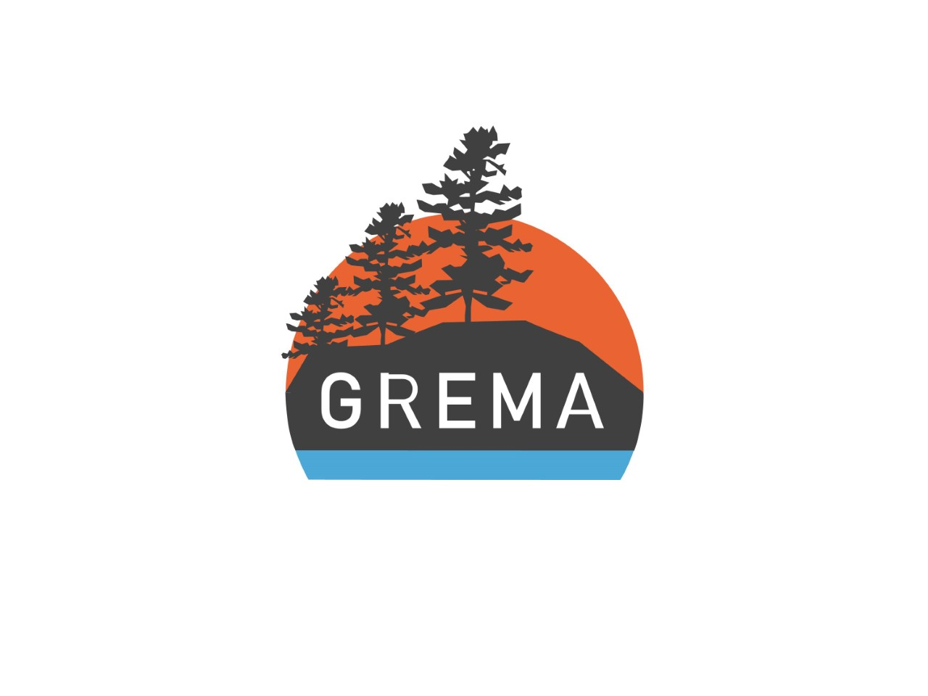


Remerciements
Supervisors
Miguel Montoro Girona (UQAT-SLU)
Yves Bergeron (UQAT-UQAM)
Patricia Raymond (MFFP)
Committee
Annie Desrochers (UQAT-IRF)
Hubert Morin (UQAC)
Merci beaucoup
Naharin Sultana Anni
Victor Beaudet
Hugo Morin Brassard
Anoj Subedi
Akib Hasan
Olugbadieye Gideon Tobi
Deogkyu Kwon
1st Prize for Best Poster in CEF 2021 (500$)
Notes:
Thank you for the supervisors who have always been supportive and colleagues who help me to get through the challenging phd. Merci beaucoup!

